Slide 1
Case Study – Strategic Analyst
Rhodes Kirkpatrick

Slide 2
Objectives:
Given data on Sales, Cost, Partnership Type, Zip Code, and Marketing Messages
Demand is Pulled from the Marketing Message
Objective: Increase Sales, optimize Cost: That Unifies into Profit equivalent to Sales minus Cost

Slide 3
Framework
Customer Demand & Cost Optimization
Operational Reality
Strategy and Recommendation
Demand for marketing messages & Cost Associations
Unify into Profit
Quantify: Difference in Difference Study
What gains us new customers?
Importance of Precision
Investment Recommendations
Expected ROI

Slide 4
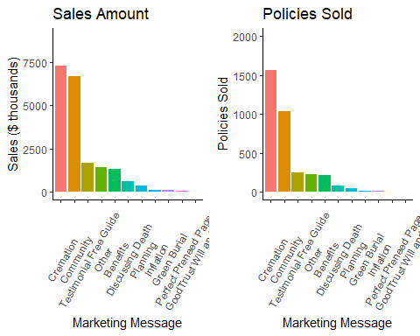
Marketing Message Overview

Slide 5
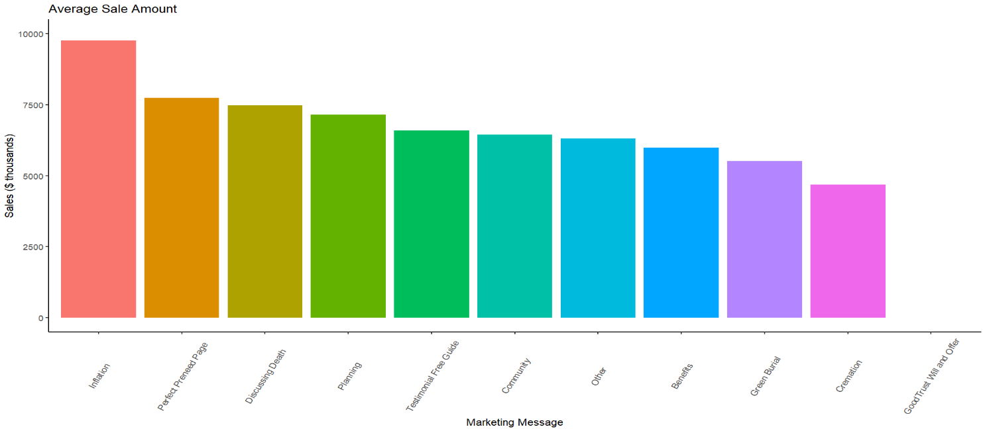
Average Sales

Slide 6
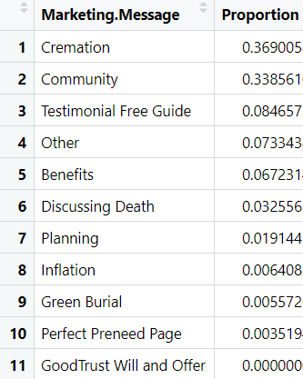
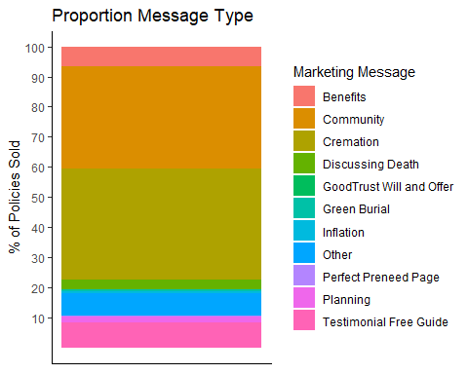
Proportionally
Key Point:
The Avg Sale outperformers
= 6.15% total policies sold.
Cremation has the lowest average sale.

Slide 7
Key Take-aways
Our top sellers are driven by volume not price
Cremation pulls in most demand, but we should probably push demand somewhere else.
Community has much better average value than Cremation

Slide 8
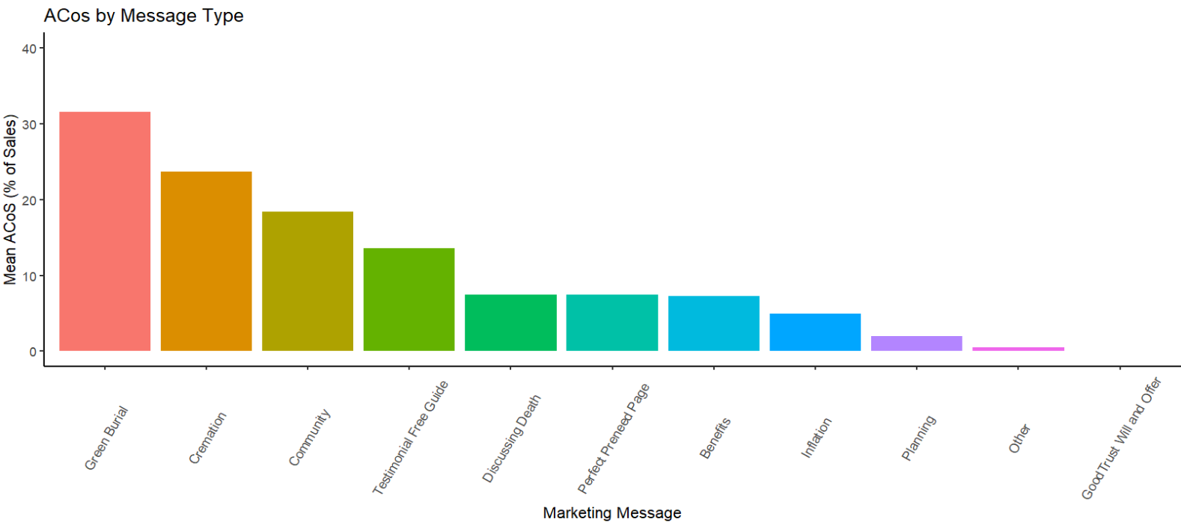
ACoS

Slide 9
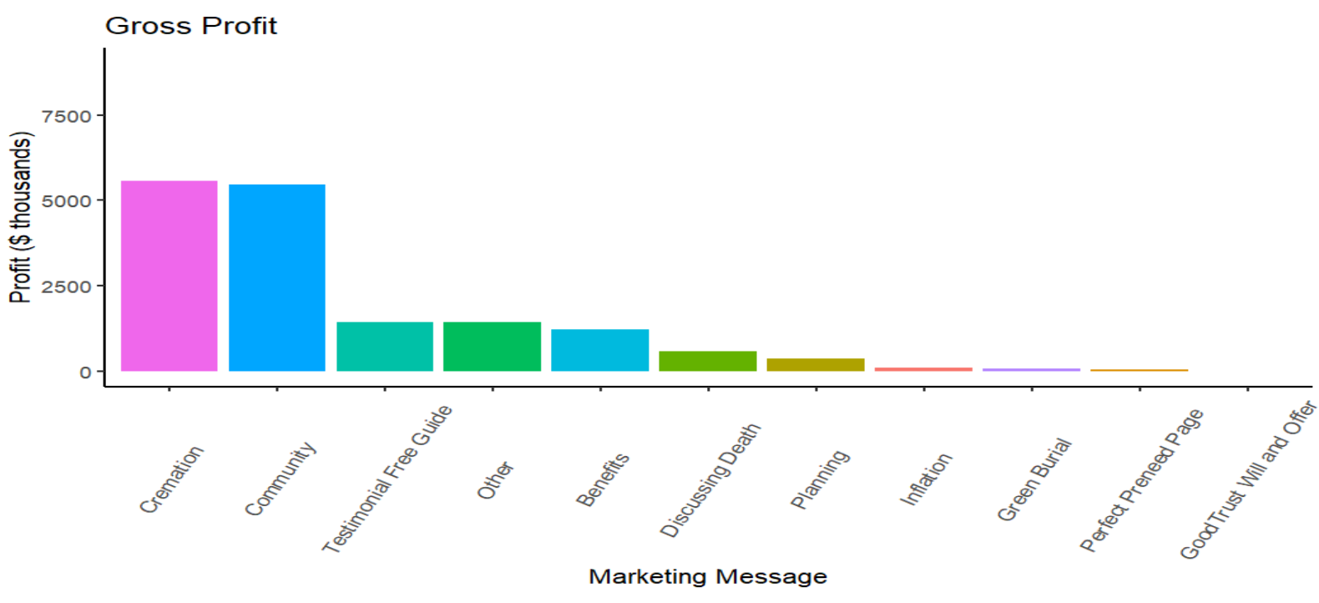
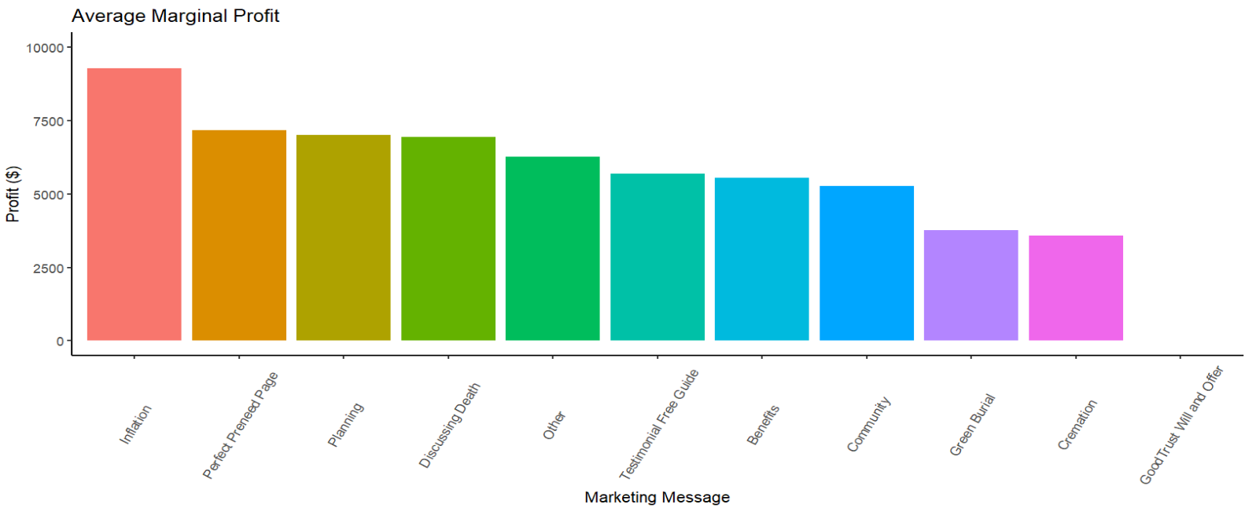
Profits
Gross Profit = Sales*(1-ACoS)
Average Marginal Profit = Average Sale*(1-ACoS)

Slide 10
Key Take-aways
Green Burial is an outlier, Top seller’s ACOS a step higher than the rest
Driven by higher value and lower cost, Community is performing as well as cremation.
Higher Average Cost to the messages we sell more of in almost exact order.
Does this reflect quality?

Slide 11
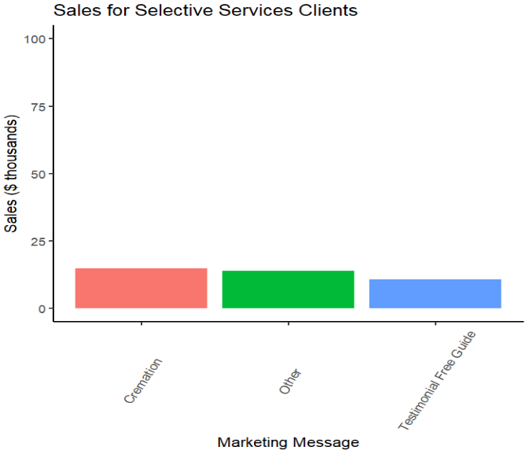
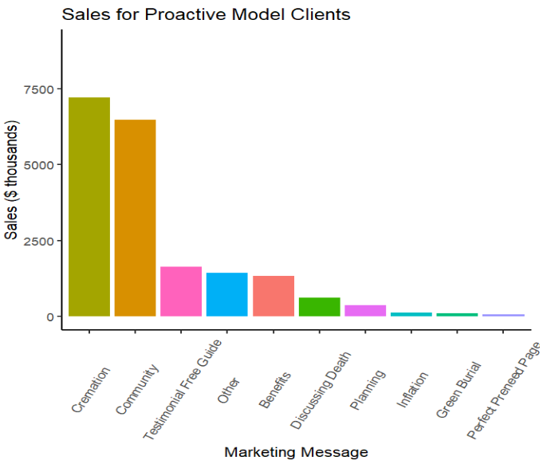
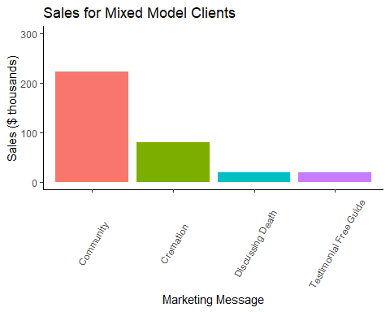
Sales for Model Type

Slide 12
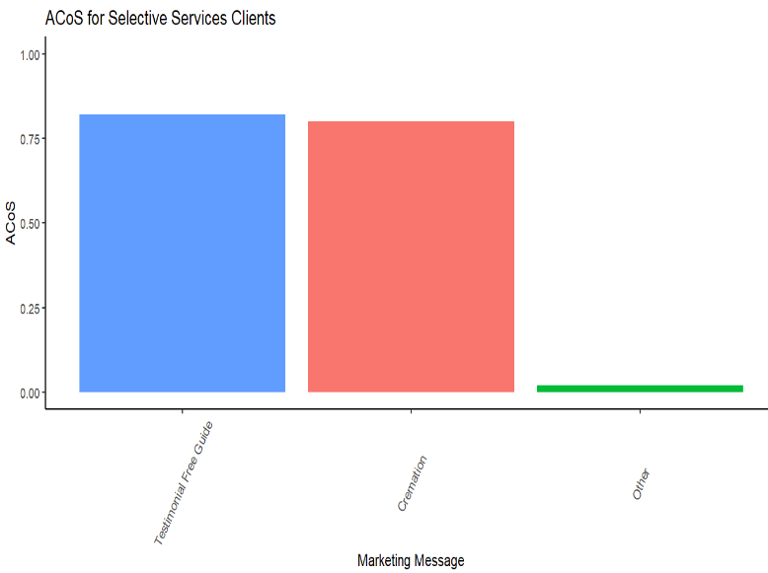
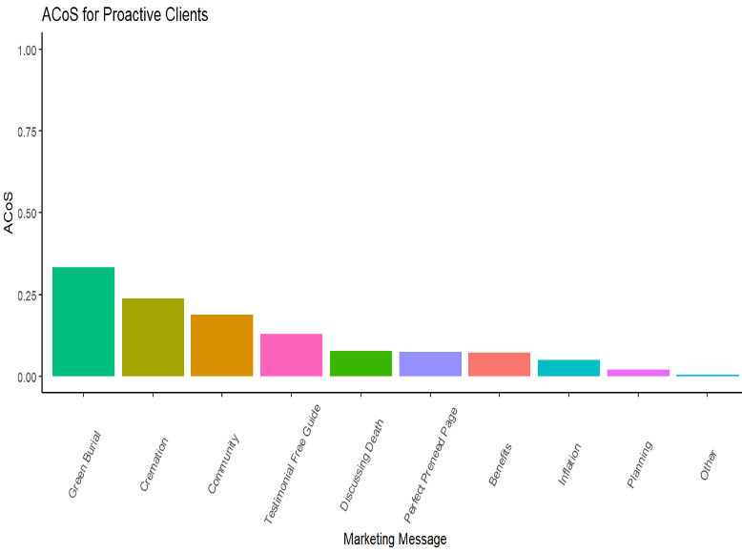
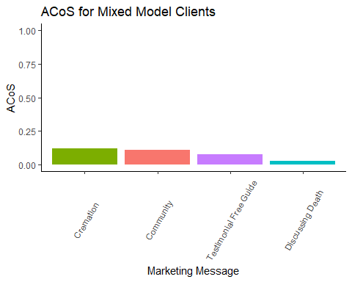
ACoS for Model Type

Slide 13
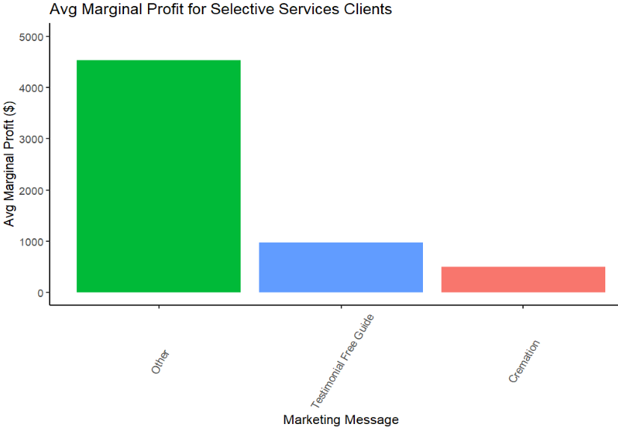
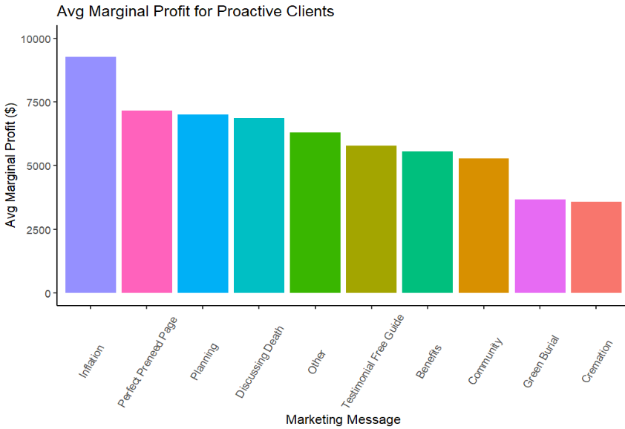
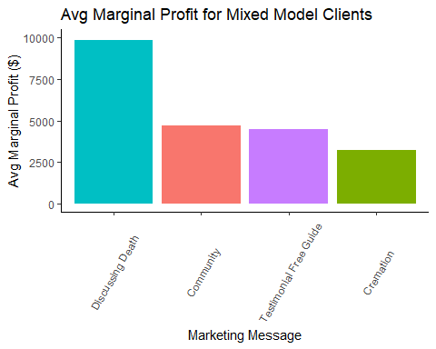
Marginal Profits for Model Type

Slide 14
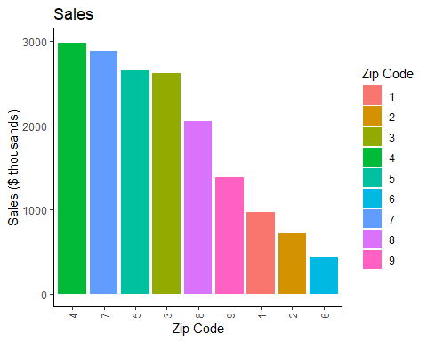
Sales by Zip Code

Slide 15
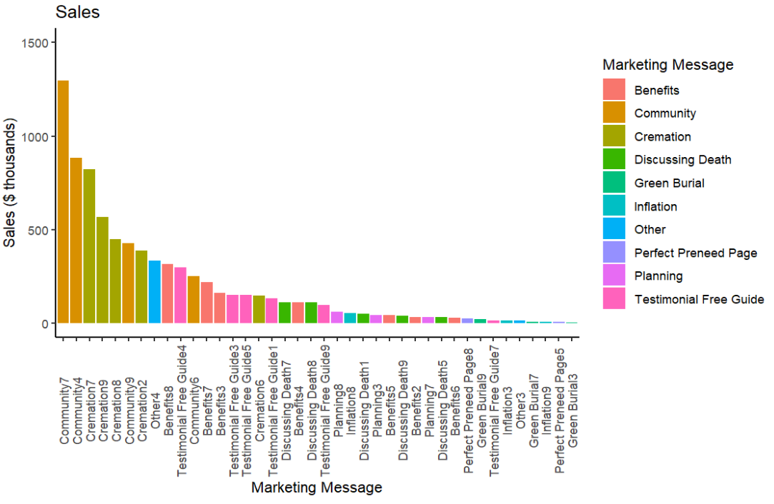
Zip Code and Marketing Message Charts

Slide 16
Take-Aways
Community for zip 7 is a cash-cow with high marginal profits and statistically significant high sales and low cost and in zip 4 shares these traits to lesser extent.
Community for zip 6 has great sales for a low sale zip and lower than average cost with high marginal profit.
Cremation performs well across all zip codes in terms of cost, is cash cow however, only good proportional sales in zips 2 and 9 and all marginal profits low.
Benefits does well in zip code 8 and Testimonial Free guide has double the demand in Zip 4 than its 2nd place.
Perfect Preneed does great in zip code 5 and 8 relative to its own sales.
But are these causal? How do they match up against their own sales and the zip sale trend?

Slide 17
Difference in Difference and Analyzing our Case
We want a causal understanding of message performance in Sales and Cost.
There are many factors that could be correlated with each other (i.e. most sales happen in a specific zip code, there are less messages to compete with in a zip code, a message is performing in line with its own expectations distributed evenly)
We need to isolate performance in context after separating differences from that specific context
3 main variables to look at: Model Type, Zip Code (geography), Message type

Slide 18
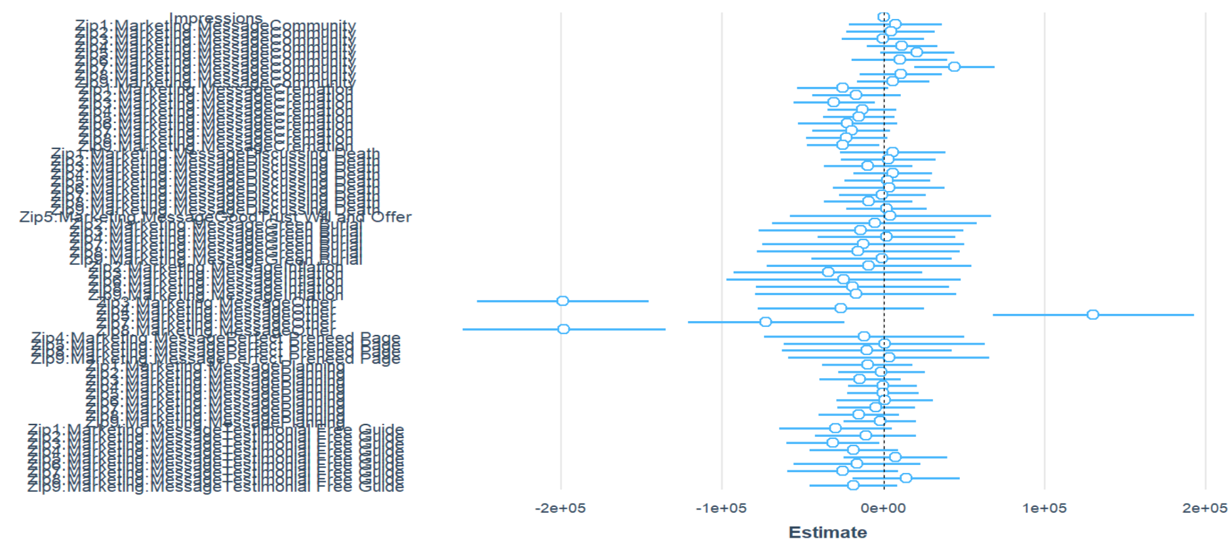
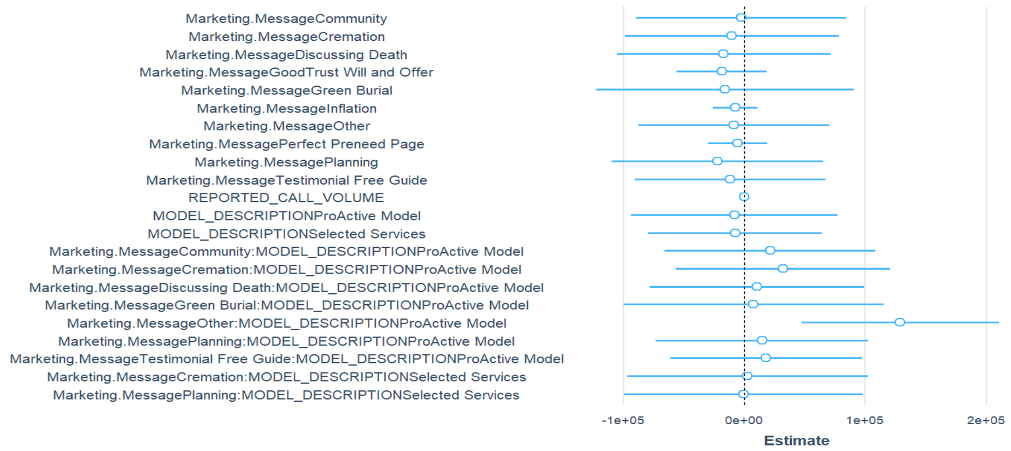
What Makes a Message Successful in Sales:

Slide 19
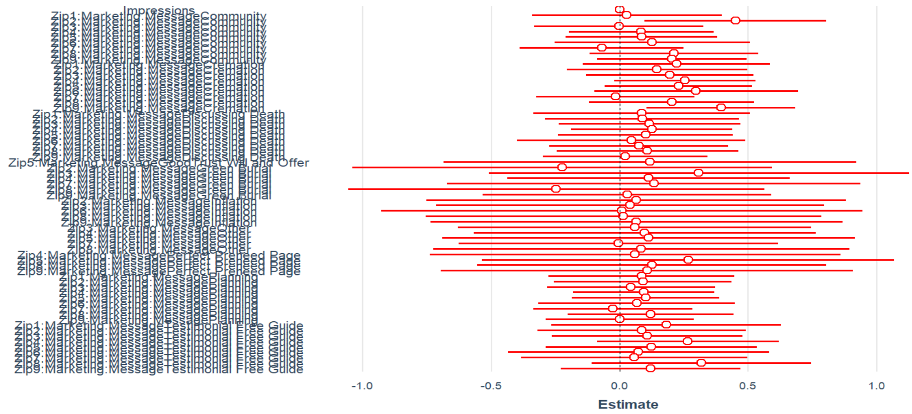
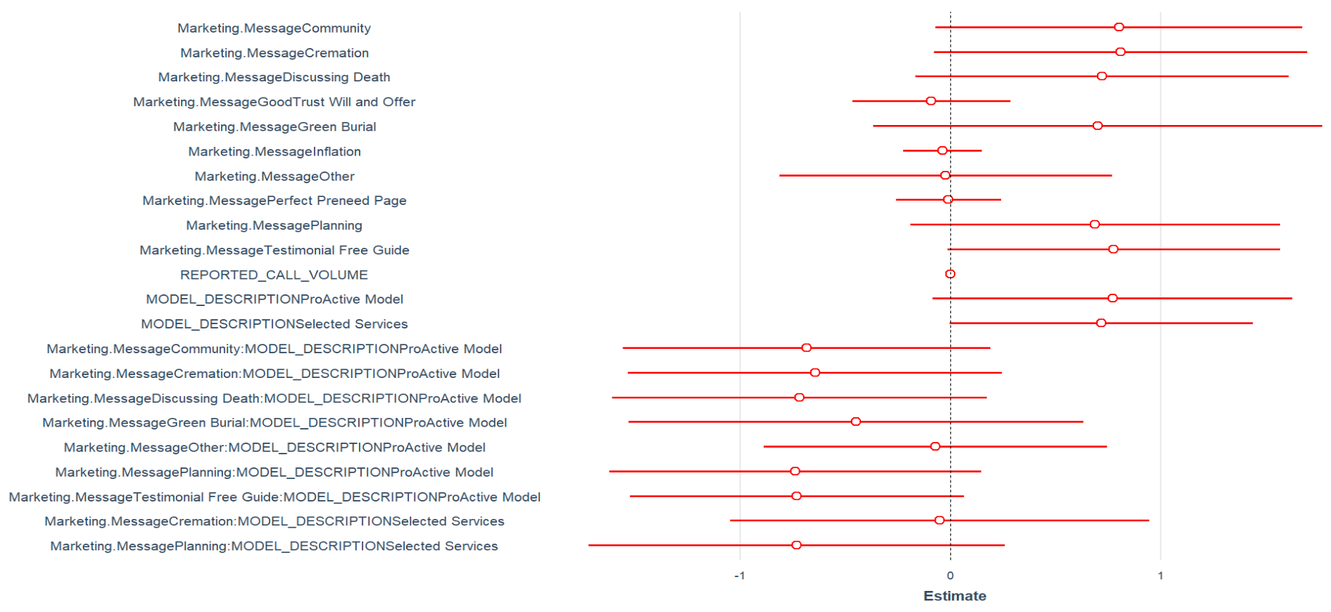
What Makes a Message Successful in Cost:

Slide 20
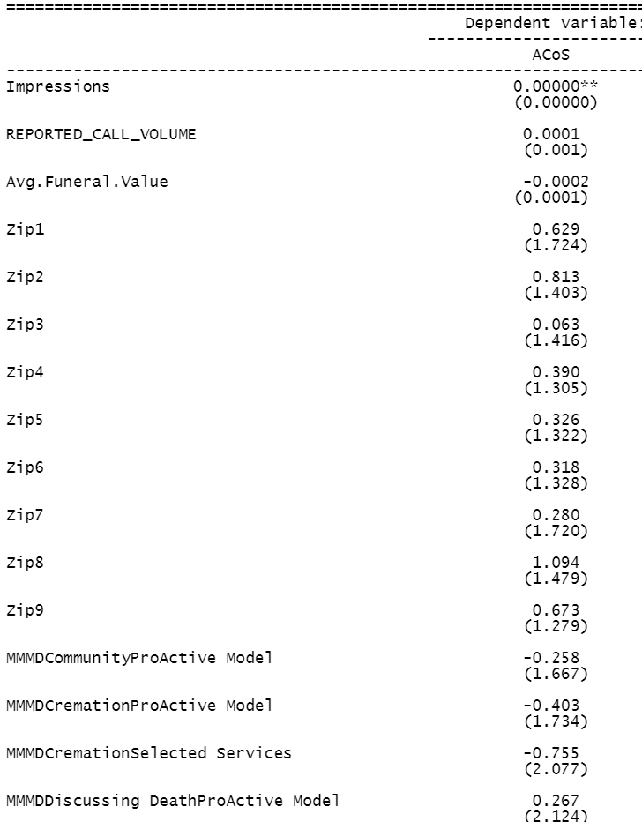
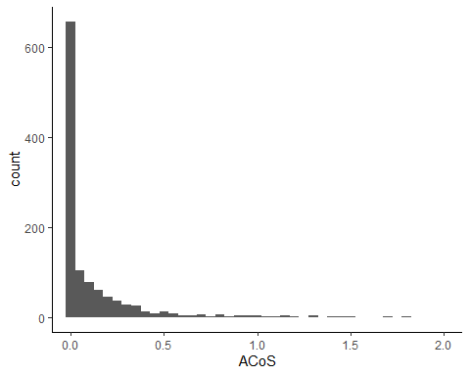
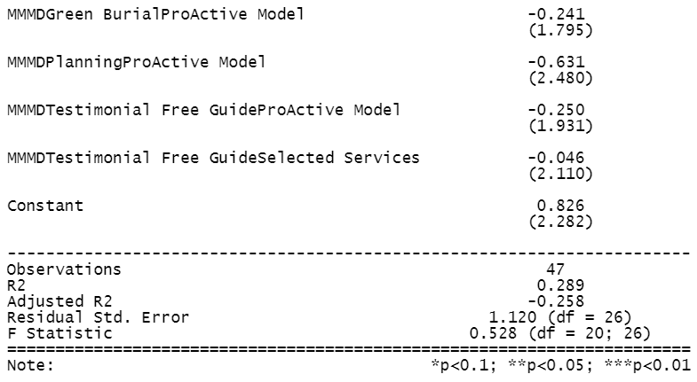
Limiting ACoS Outliers
ACoS should never be above 1.
- ACoS Outliers tend to be higher in Zips 1,2,8, and 9 and Discussing Death for the Proactive model.
- Cremation has highest count of outliers
- Otherwise, no correlation to other data, so look into these projects.

Slide 21
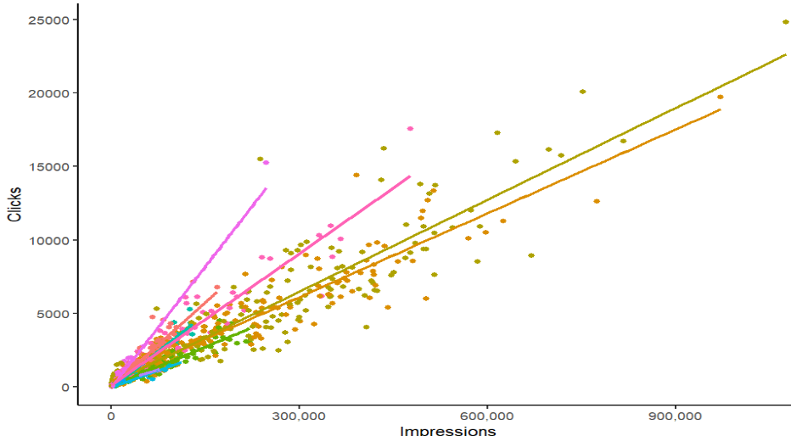
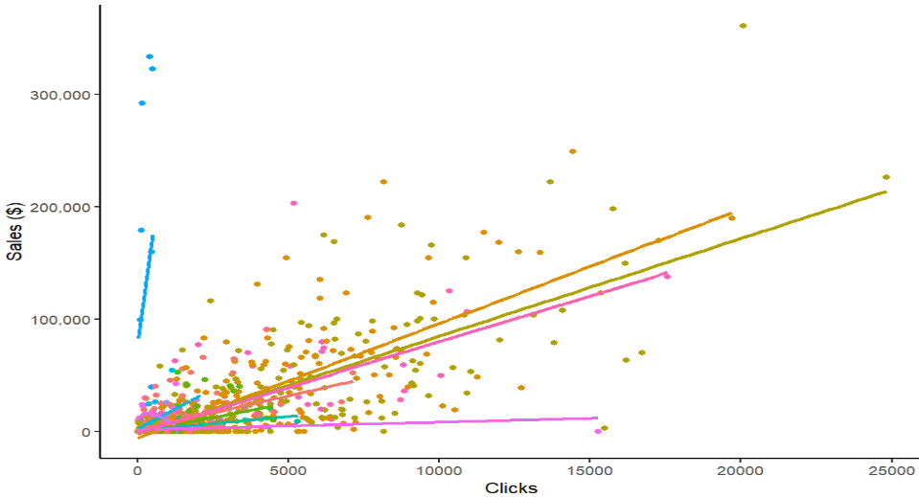
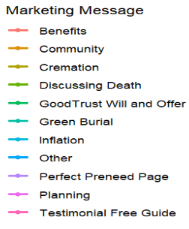
Operations: How we Get New Customers

Slide 22
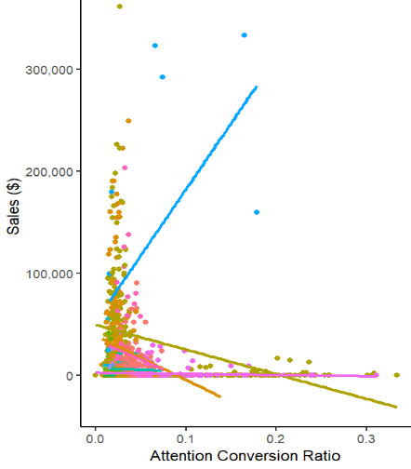
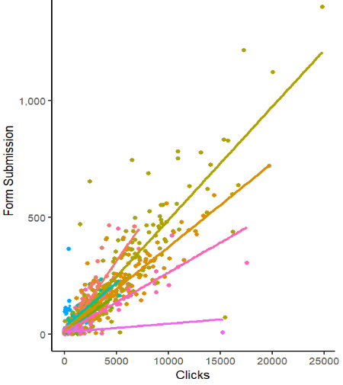
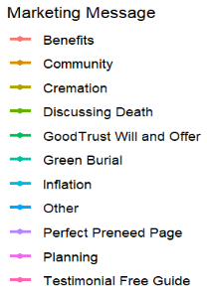
Specificity vs Quantity

Slide 23
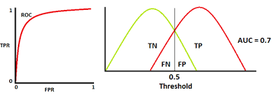
True Positive/False Positive Trade Off
Our Facebook Ads are tailored pre-funeral home release, however, there is always a sensitivity (true positive) and specificity (false positive) trade-off.
Since we have no correlation between our conversion ratio and sales we are higher on the true and false positives.

Slide 24
Does this make Sense for Our Business?
Yes! (To a large extent, in most cases)
We would rather lean farther into true positives given digital marginal costs are small and ACoS is generally low.
The main concern when shifting strategies is whether we can stay on the same efficient frontier and not over-estimate demand.
We would not want to use this strategy for low demand and high cost marketing messages, this risks both negative accounting margins and major opportunity cost.

Slide 25

Recommendations for increasing Sales
Major Shift
Transfer large ad proportion to Community from Cremation
Prioritize
Prioritize ProActive Models, use only “Other” for selective services.
Increase
Increase Discussing Death in Zip Code 1 and for mixed model, efforts on “Other” Campaigns with zip in mind.
Push
Push Demand for Inflation and Perfect Preneed zips 5 and 8. Push both in ProActive Model.
Prioritize
Prioritize Zips 5 and 7 for Testimonial Free Guide.
Zip Specific
Target Green Burial in Zips 2 and 8, and be more zip specific with “Other” campaigns.

Slide 26
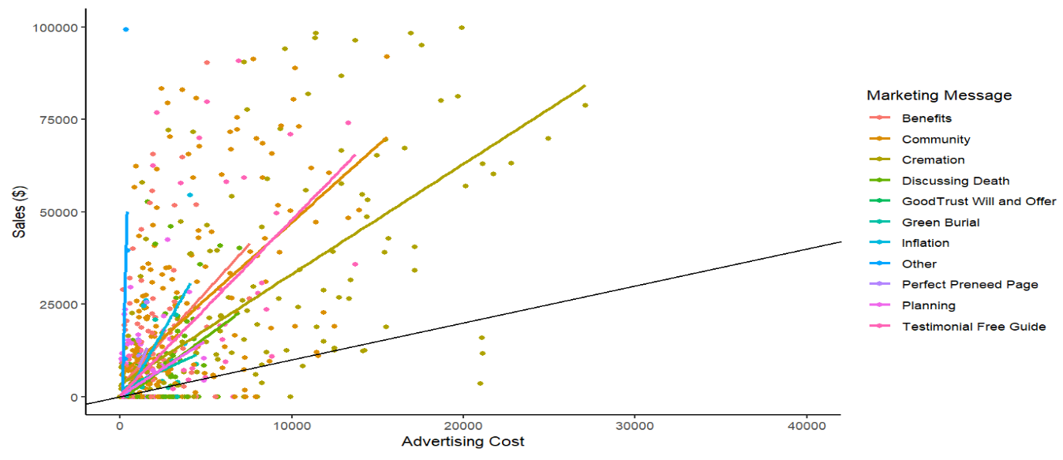

ROI Chart

Slide 27

ROI Calculations and Conclusion
Swapping policies sold from cremation to community:
519 policy increase = $3,348,847 sales
At 18.44% ACoS = $617,527
= 442% ROI
Minus 519 policies from cremation = $1,857,812.4 net cost
= $873,503 Economic Profit and 35% difference accounting ROI

